Slide 1
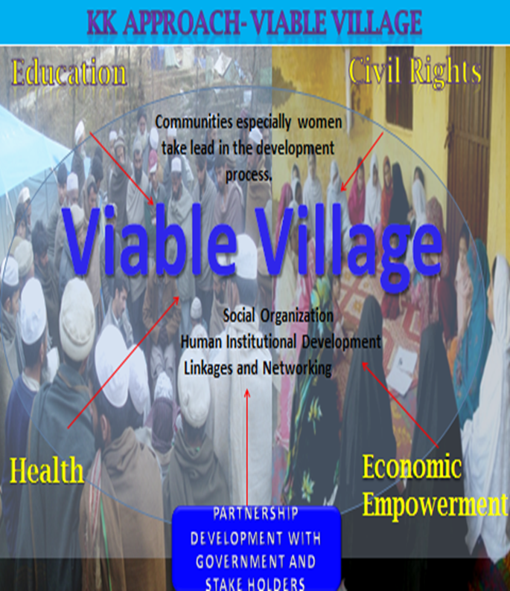

Slide 2
Viable village
Since its start, KK had a holistic and indigenous approach to community development with women at the core alongside men
It evolved into a formal model in 2013, and became a part of KK identity which ensures:
communities, especially women, own and take the lead in the development process
guarantees sustainable development and increased community self reliance.
effectively connect grass root issues at policy level and enable communities to negotiate with authorities
Is cost effective, ensures easier access to employment, lowers poverty and contributes to women’s empowerment

Slide 3
Working strategies
Base lining and Village Development plan.
Social organisation (formation of women and men organisation at village level.
Human and institutional development.
Partnership development. (establishment functional linkages of communities with government, NGOs and private sector.)

Slide 4
Expected Outcomes (5-10 years)
Indicators:
Functional Women and Men organisations and its Registration with relevant authorities.
Significant increases in women issued with government identity cards (CNIC), registered as voters and casting their votes.
Reducing rates of gender based violence
Increased female access to the basic human rights of education, health, livelihood, clean drinking water and decent standard of living
Disaster Response Plans in place

